Slide 1

CENG 334 – Operating Systems
05- Scheduling
Asst. Prof. Yusuf Sahillioğlu
Computer Eng. Dept, , Turkey

Slide 2
Process Scheduling
<number> / 38
Process scheduler coordinates context switches, which gives the illusion of having its own CPU to each process.
Keep CPU busy (= highly-utilized) while being fair to processes.
Threads (within a process) are also schedulable entities; so scheduling ideas/algorithms we will see apply to threads as well.

Slide 3

Context Switch
<number> / 38
Important ‘cos it allows new processes run by the processor.
Overhead ‘cos while switching the context no work is done for the processes.
Notes:
Overhead: Any cost or expenditure (monetary, time, effort or otherwise) incurred in a project or activity, which does not directly contribute to the progress or outcome of the project or activity.

Slide 4
Context Switch
<number> / 38
Context switch is kernel code.
Process is user code.
Process A
Process B
user code
kernel code
context switch
Time
user code
kernel code
context switch
user code

Slide 5
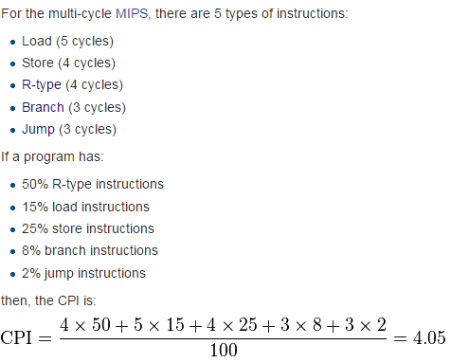
Context Switch
<number> / 38
Context overhead in Ubuntu 9.04 is 5.4 usecs on a 2.4GHz Pentium 4.
This is about 13.200 CPU cycles.
  Don’t panic; not quite that many instructions since CPI > 1

Slide 6
Process Scheduling
<number> / 38
Scheduler interleaves processes in order to give every process the illusion of having its own CPU, aka concurrency, pseudo parallelism.
  Even with one CPU (instruction executer), you can multitask: music, code, download, ..
Process scheduler selects among available processes for next execution on CPU.
Maintains scheduling queues of processes
  Job queue – set of all processes in the system
  Ready queue – set of all processes ready to execute
  Device queues – set of processes waiting for an I/O device //scanf(“%d”, &number);
  Processes migrate among the various queues

Slide 7

Process Scheduling
<number> / 38
e.g., sleep(1000);

Slide 8
Schedulers
<number> / 38
Long-term scheduler (or job scheduler): selects which processes should be brought into the ready queue (from the job queue).
  Controls the degree of multitasking (all ready processes execute).
  Slow: secs, mins. (loads a new process into memo when 1 process terminats).
Short-term scheduler (or CPU scheduler): selects which process should be executed next and allocates CPU.
  Sometimes the only scheduler in a system.
  Must be fast: millisecs (you cannot allow 1 process using CPU for a long time).

Slide 9

Schedulers
<number> / 38
Processes can be described as either
  I/O-bound process: spends more time doing I/O than computatins.
  CPU-bound process: operate on memo variable, do arithmetic, ..
CPU burst: a time period during which the process want to continuously run in the CPU without making I/O
  Time between two I/Os.
  I/O-bound processes have many short CPU bursts
  CPU-bound process has few very long CPU bursts
Example I/O-bound program?
Example CPU-bound program?
Notes:
Example: Copy program that reads from a file and writes to another file. Example CPU-bound: factorial(x) (or calculator)

Slide 10
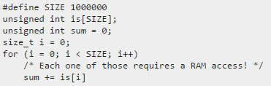
Schedulers
<number> / 38
RAM I/O bound example.
If your input is large and the calculation small, you are memory-bound, which is one type of I/O bottleneck.
Parallelizing your program is useless here if you are on a mainstream desktop computer where all processors sit behind a single bus linking to RAM: the bus is the bottleneck.
Parallelizing that by splitting the big array for each of your cores does not lead to a significant speedup.
Also, the cache is not going to help, since we are just reading each value once.

Slide 11
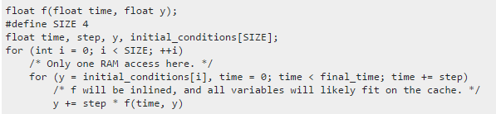
Schedulers
<number> / 38
CPU bound example.
If the input is small, but you do a lot of operations on it, then we are CPU-bound, and multi-threading can actually divide the runtime by the number of processors.
If we run one initial condition case in each processor, the time will be divided by the number of processors.

Slide 12
Schedulers
<number> / 38
Selects from among the processes in ready queue, and allocates the CPU to one of them
CPU scheduling decisions may take place when a process:
  1. Switches from running to waiting state //semaphore, I/O, ..
  2. Switches from running to ready state //time slice
  3. Switches from waiting to ready //waited event (mouse click) occurred
  4. Terminates //exit(0);
Scheduling under 1 and 4 is non-preemptive (leaves voluntarily)
  Batch systems: scientific computers, payroll computations, ..
All other scheduling is preemptive (kicked out)
  Interactive systems: user in the loop.
Scheduling algo is triggered when CPU becomes idle
  Running process terminates
  Running process blocks/waits on I/O or synchronization

Slide 13
Schedulers
<number> / 38
Scheduling criteria
  CPU utilization: keep the CPU as busy as possible
  Throughput: # of processes that complete their execution per time unit
  Turnaround time: amount of time to execute a particular process = its lifetime
  Waiting time: amount of time a process has been waiting in the ready queue; subset of lifetime
  Response time: amount of time it takes from when a request was submitted until the first response is produced
    Ex: When I enter two integers I want the result to be returned as quick as possible; small response time in interactive systems.
      Move them from waiting→ready→running state quickly.

Slide 14
Schedulers
<number> / 38
Scheduling criteria
  Max CPU utilization
  Max throughput
  Min turnaround time
  Min waiting time
  Min response time

Slide 15

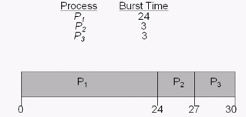

First Come First Served Scheduling
<number> / 38
An unfair non-preemptive CPU scheduler, aka FCFS or FIFO.
Idea: run until done!
Example:
Notes:
Non-preemptive: process is never kicked out of the CPU (has to wait for the process to finish).

Slide 16


First Come First Served Scheduling
<number> / 38
An unfair non-preemptive CPU scheduler, aka FCFS or FIFO.
Idea: run until done!
Example:

Slide 17
First Come First Served Scheduling
<number> / 38
An unfair non-preemptive CPU scheduler, aka FCFS or FIFO.
Idea: run until done!
Example:
Throughput: in 30
secs, 3 processes
completed
3 processes
completed

Slide 18
First Come First Served Scheduling
<number> / 38
An unfair non-preemptive CPU scheduler, aka FCFS or FIFO.
Idea: run until done!
Example:
Throughput: in 30
secs, 3 processes
completed
FCFS does not affect throughput
3 processes
completed

Slide 19
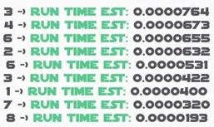
Shortest Job First (SJF)
<number> / 38
An unfair non-preemptive CPU scheduler.
Idea: run the shortest jobs first.
  Runtime estimate for the next CPU-burst is an issue ☹
  Optimal: provides minimum waiting time.
  May cause starvation ☹

Slide 20
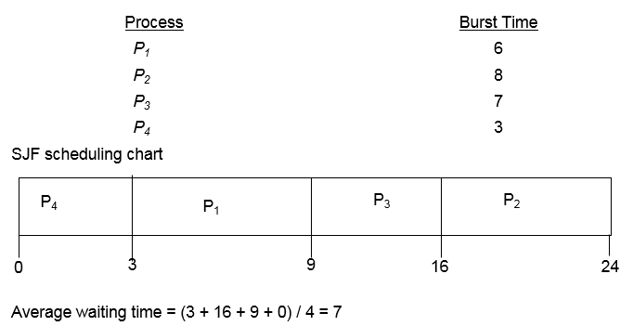
Shortest Job First (SJF)
<number> / 38
An unfair non-preemptive CPU scheduler.
Idea: run the shortest jobs first.

Slide 21


Shortest Job First (SJF)
<number> / 38
An unfair non-preemptive CPU scheduler.
Estimate the length of the CPU burst of a process before executing that burst.
Use the past behavior (exponential averaging).
//alpha usually 0.5
If you are running the program several times, you can derive a profile for these estimates.

Slide 22

Shortest Job First (SJF)
<number> / 38
An unfair non-preemptive CPU scheduler.
Estimation of the length of the next CPU burst (alpha=0.5).

Slide 23
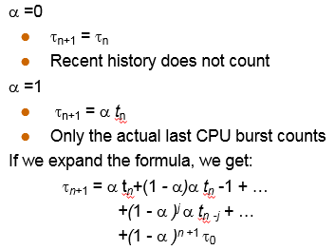
Shortest Job First (SJF)
<number> / 38
An unfair non-preemptive CPU scheduler.
Estimation of the length of the next CPU burst.
Why called exponential averaging?

Slide 24
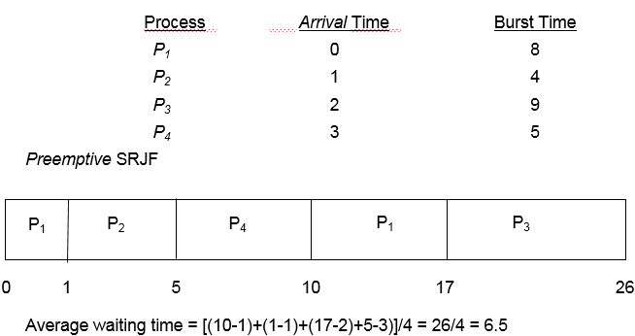
Shortest Remaining Job First (SRJF)
<number> / 38
An unfair preemptive CPU scheduler.
Idea: run the shortest jobs first.
A variant of SJF.
  Still needs those CPU-burst estimates ☹
  Preemptive version of Shortest Job First.
  While job A is running, if a new job B comes whose length is shorter than the remaining time of job A, then B preempts (kicks out of CPU) A and B starts to run.

Slide 25
Priority Scheduling
<number> / 38
An unfair CPU scheduler.
A priority number (integer) is associated with each process
The CPU is allocated to the process with the highest priority (smallest integer = highest priority)
  Preemptive (higher priority process preempts the running one)
  Non-preemptive
SJF is a priority scheduling where priority is the predicted next CPU burst time
Prioritize admin jobs as another example
Problem: Starvation – low priority processes may never execute
Solution: ?

Slide 26
Priority Scheduling
<number> / 38
An unfair CPU scheduler.
A priority number (integer) is associated with each process
The CPU is allocated to the process with the highest priority (smallest integer = highest priority)
  Preemptive (higher priority process preempts the running one)
  Non-preemptive
SJF is a priority scheduling where priority is the predicted next CPU burst time
Prioritize admin jobs as another example
Problem: Starvation – low priority processes may never execute
Solution: Aging – as time progresses increase the priority of the process

Slide 27
Lottery Scheduling
<number> / 38
A kind of randomized priority scheduling scheme
Give each thread some number of “tickets”
  The more tickets a thread has, the higher its priority
On each scheduling interval:
  Pick a random number between 1 and total # of tickets
  Scheduling the job holding the ticket with this number
How does this avoid starvation?
  Even low priority threads have a small chance of running.

Slide 28
Lottery Scheduling
<number> / 38
An example
Job A
Job B
Job C
30
10
60
Round 1
26
A
i/o
C
C
i/o
65
i/o
Round 2
65
Round 2
Round 3
92
C would win ... but it is still blocked!
Round 4
33
B
i/o
Round 5
7
A
i/o

Slide 29
Priority Inversion
<number> / 38
A problem that may occur in priority scheduling systems.
A high priority process is indirectly ”preempted” by a lower priority task effectively "inverting" the relative priorities of the two tasks.
It happened on the Mars rover Sojourner.
http://www.drdobbs.com/jvm/what-is-priority-inversion-and-how-do-yo/230600008
https://users.cs.duke.edu/~carla/mars.html

Slide 30
Priority Inversion
<number> / 38
A acquires lock for resource R and runs
A blocks on resource R
High
A
A
B
Medium
B
C
Low
C
C
C acquires a lock for resource R
C releases lock
B runs
C runs
B runs
B ”seems to” have a higher priority than A!
Hence priority inversion!
Notes:
When the system begins execution, thread C(a low priority thread) is released and executes immediately since there are no other higher priority threads executing.
Shortly after it starts, it acquires a lock on resource R.
Then, thread A is released and preempts thread C since it's of higher priority.
Then thread B, a medium priority thread, is released but doesn't execute because higher priority thread A is still executing.
Then, thread A attempts to acquire a lock on resource R, but cannot since thread C (a low priority thread) still owns it.
This allows thread B to execute in its place, which effectively violates the priority-order execution of the system, resulting in what we call priority inversion.
After several context switches, C releases the lock, and A is scheduled again.

Slide 31
Priority Inheritance
<number> / 38
A acquires lock for resource R and runs
A blocks on resource R
High
A
A
Medium
Low
C
C
C acquires a lock for resource R
C runs and releases lock
C “inherits” A’s priority
Hence priority inheritance!
C finishes quickly (despite the existence of another process, say B (prev slide)) and releases the lock, which helps originally-important A to resume quickly.

Slide 32
Fair-share Scheduling
<number> / 38
We have assumed that each process is of its own, with no regard who its owner is.
CPU allocation is split to the number of processes a user has.
A user running a single process would run 10 times as fast, than another user running 10 copies of the same process.

Slide 33
Round Robin Scheduling
<number> / 38
A fair preemptive CPU scheduler.
Idea: each process gets a small amount of CPU time (time quantum).
  Usually 10-100 milliseconds. Comments on this value?
If there are n processes in the ready queue and the time quantum is q, then no process waits more than ???? time units. Good response time.

Slide 34
Round Robin Scheduling
<number> / 38
A fair preemptive CPU scheduler.
Idea: each process gets a small amount of CPU time (time quantum).
  Usually 10-100 milliseconds. Comments on this value?
If there are n processes in the ready queue and the time quantum is q, then no process waits more than ???? time units. Good response time.
Quantum too large: becomes FCFS.
Quantum too small: interleaved a lot; context switch overhead.
Answer: ???? = (n-1)q
Preemptive: After time expires, process is preempted and added to the end of the ready queue.

Slide 35
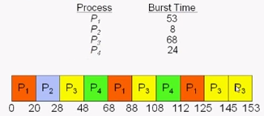
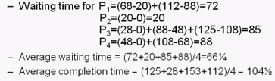
Round Robin Scheduling
<number> / 38
A fair preemptive CPU scheduler.
Idea: each process gets a small amount of CPU time (time quantum).
  Usually 10-100 milliseconds. Comments on this value?
If there are n processes in the ready queue and the time quantum is q, then no process waits more than ???? time units. Good response time.
Example with
quantum = 20:
//not minimize total waiting t, unlike SJF.

Slide 36

Round Robin Scheduling
<number> / 38
A fair preemptive CPU scheduler.
Time quantum and # of context switches.
These are min # of context switches above; why min?

Slide 37
Round Robin Scheduling
<number> / 38
A fair preemptive CPU scheduler.
Time quantum and # of context switches.
‘cos process may do I/O or sleep/wait/block() on a semaphore in which case new/additional context switches will be done.

Slide 38

Round Robin Scheduling
<number> / 38
A fair preemptive CPU scheduler.
Quite fair
  No starvation
  Divides the CPU power evenly to the processes
  Provides good response times
Turnaround time (lifetime) not optimal.
  Expect decrease in the avg
  turnaround time as quantum++

Slide 39
Round Robin Scheduling
<number> / 38
A fair preemptive CPU scheduler.
Quite fair
  No starvation
  Divides the CPU power evenly to the processes
  Provides good response times
Turnaround time (lifetime) not optimal.
  Expect decrease in the avg
  turnaround time as quantum++
  (‘cos it’ll take more time for you
  to resume)

Slide 40
Demo Page
<number> / 38
Play with the scheduling demo at http://user.ceng.metu.edu.tr/~ys/ceng334-os/scheddemo/
which is prepared by Onur Tolga Sehitoglu.

Slide 41
Multilevel Queue
<number> / 38
All algos so far using a single Ready queue to select processes from.
Have multiple queues and schedule them differently.

Slide 42
Multilevel Queue
<number> / 38
Have multiple queues and schedule them differently.
Ready queue is partitioned into separate queues.
  foreground (interactive) //do Round Robin (RR) here
  background (batch) //do FCFS here
Scheduling must be done between the queues
  Sometime serve this queue; sometime that queue; ..
  Fixed priority scheduling; (i.e., serve all from foreground then from background). Possibility of starvation.
  Time slice: each queue gets a certain amount of CPU time which it can schedule amongst its processes; i.e., 80% to foreground in RR; 20% to background in FCFS.

Slide 43
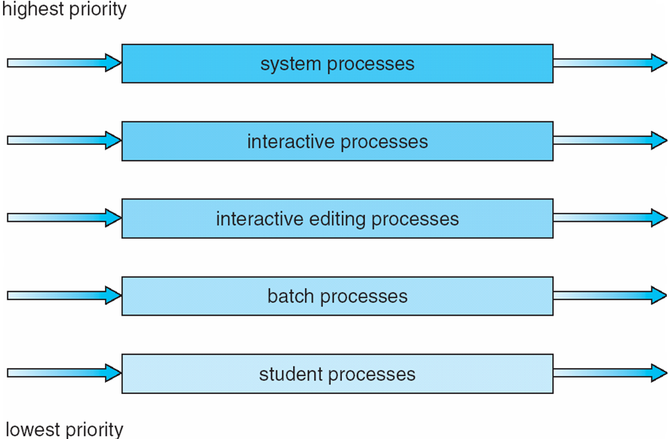
Multilevel Queue
<number> / 38
Have multiple queues and schedule them differently.

Slide 44
Multilevel Queue
<number> / 38
Once process is assigned to a queue its queue does not change.
Feedback queueue to handle this problem.
  A process can move between the various queues; aging can be implemented this way
  Multilevel-feedback-queue scheduler defined by the following parameters:
    number of queues
    scheduling algorithms for each queue
    method used to determine when to upgrade a process
    method used to determine when to demote a process
    method used to determine which queue a process will enter when that process needs service
Now we have a concrete algo that can be implemented in a real OS.

Slide 45
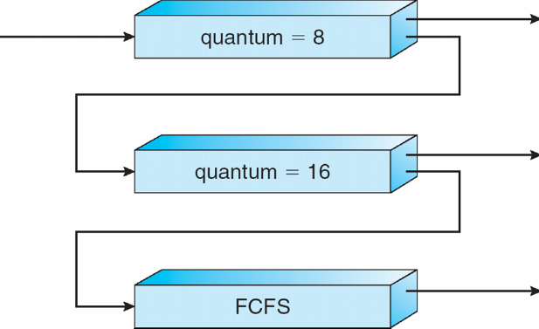
Multilevel Queue
<number> / 38
An example with 3 queues.
Q0: RR with time quantum 8 milliseconds
Q1: RR time quantum 16 milliseconds (more CPU-bound here; learn)
Q2: FCFS //not interactive processes (initially we may not know; learn)
Scheduling
  A new job enters queue Q0 which is served RR (q=8). When it gains CPU, job receives 8 milliseconds. If it does not finish in 8 milliseconds, job is moved to queue Q1.
  At Q1 job is again served RR and receives 16 additional milliseconds. If it still does not complete, it is preempted and moved to queue Q2.

Slide 46
Multi-Processor Scheduling
CPU scheduling more complex when multiple CPUs are available
Homogeneous processors within a multiprocessor system
  multiple physical processors
  single physical processor providing multiple logical processors
    hyperthreading
    multiple cores
Notes:
13/03/07

Slide 47
Multiprocessor scheduling
On a uniprocessor:
  Which thread should be run next?
On a multiprocessor:
  Which thread should be run on which CPU next?
What should be the scheduling unit?
  Threads or processes
    Recall user-level and kernel-level threads
  In some systems all threads are independent,
    Independent users start independent processes
  in others they come in groups
    Make
    Originally compiles sequentially
    Newer versions starts compilations in parallel
      The compilation processes need to be treated as a group and scheduled to maximize performance
Notes:
13/03/07

Slide 48
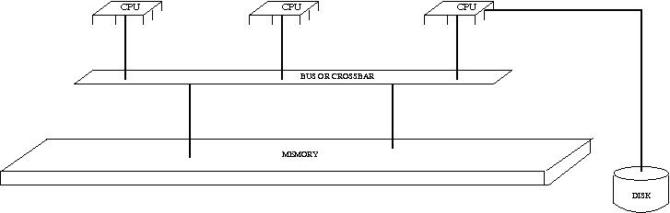
Multi-Processor Scheduling
Asymmetric multiprocessing
  A single processor (master) handles all the scheduling with regard to CPU, I/O for all the processors in the system.
  Other processors execute only user code.
  only one processor accesses the system data structures, alleviating the need for data sharing
Symmetric multiprocessing (SMP)
  Two or more identical processors are connected to a single shared main memory.
  Most common multiprocessor systems today use an SMP architecture
  Each processor does his own self-scheduling.
Notes:
13/03/07

Slide 49
Issues with SMP scheduling - 1
Processor affinity
  Migration of a process from one processor to another is costly
    cached data is invalidated
  Avoid migration of one process from one processor to another.
  Hard affinity: Assign a processor to a particular process and do not allow it to migrate.
  Soft affinity: The OS tries to keep a process running on the same processor as much as possible.
  http://www.linuxjournal.com/article/6799
Notes:
13/03/07

Slide 50
Issues with SMP scheduling - 2
Load balancing
  All processors should keep an eye on their load with respect to the load of other processors
  Processes should migrate from loaded processors to idle ones.
  Push migration: The busy processor tries to unload some of its processes
  Pull migration: The idle process tries to grab processes from other processors
  Push and pull migration can run concurrently
  Load balancing conflicts with processor affinity.
Space sharing
  Try to run threads from the same process on different CPUs simultaneously
Notes:
13/03/07

